Slide 1
Attachment 13 – Consumable Supplies and Dispensers
Landstuhl Regional Medical Center (LRMC) and its outlying clinics in Baumholder, Wiesbaden, Kleber, Pulaski
and
Rhine Ordinance Medical Center (ROBMC)

Slide 2
INSTRUCTIONS
Government will supply the following at all LRMC and outlying clinic locations:
  Hand Soap Dispensers and refills
  Hand Sanitizer Dispensers and refills
  Hand Towel Dispensers
  Toilet Paper Dispensers
Contractor will provide at all LRMC and outlying clinic locations:
  Compatible hand towel refills at
  Compatible toilet paper refills
  Toilet brushes
  Sanitary towel bags (Feminine Hygiene Bags)

Slide 3
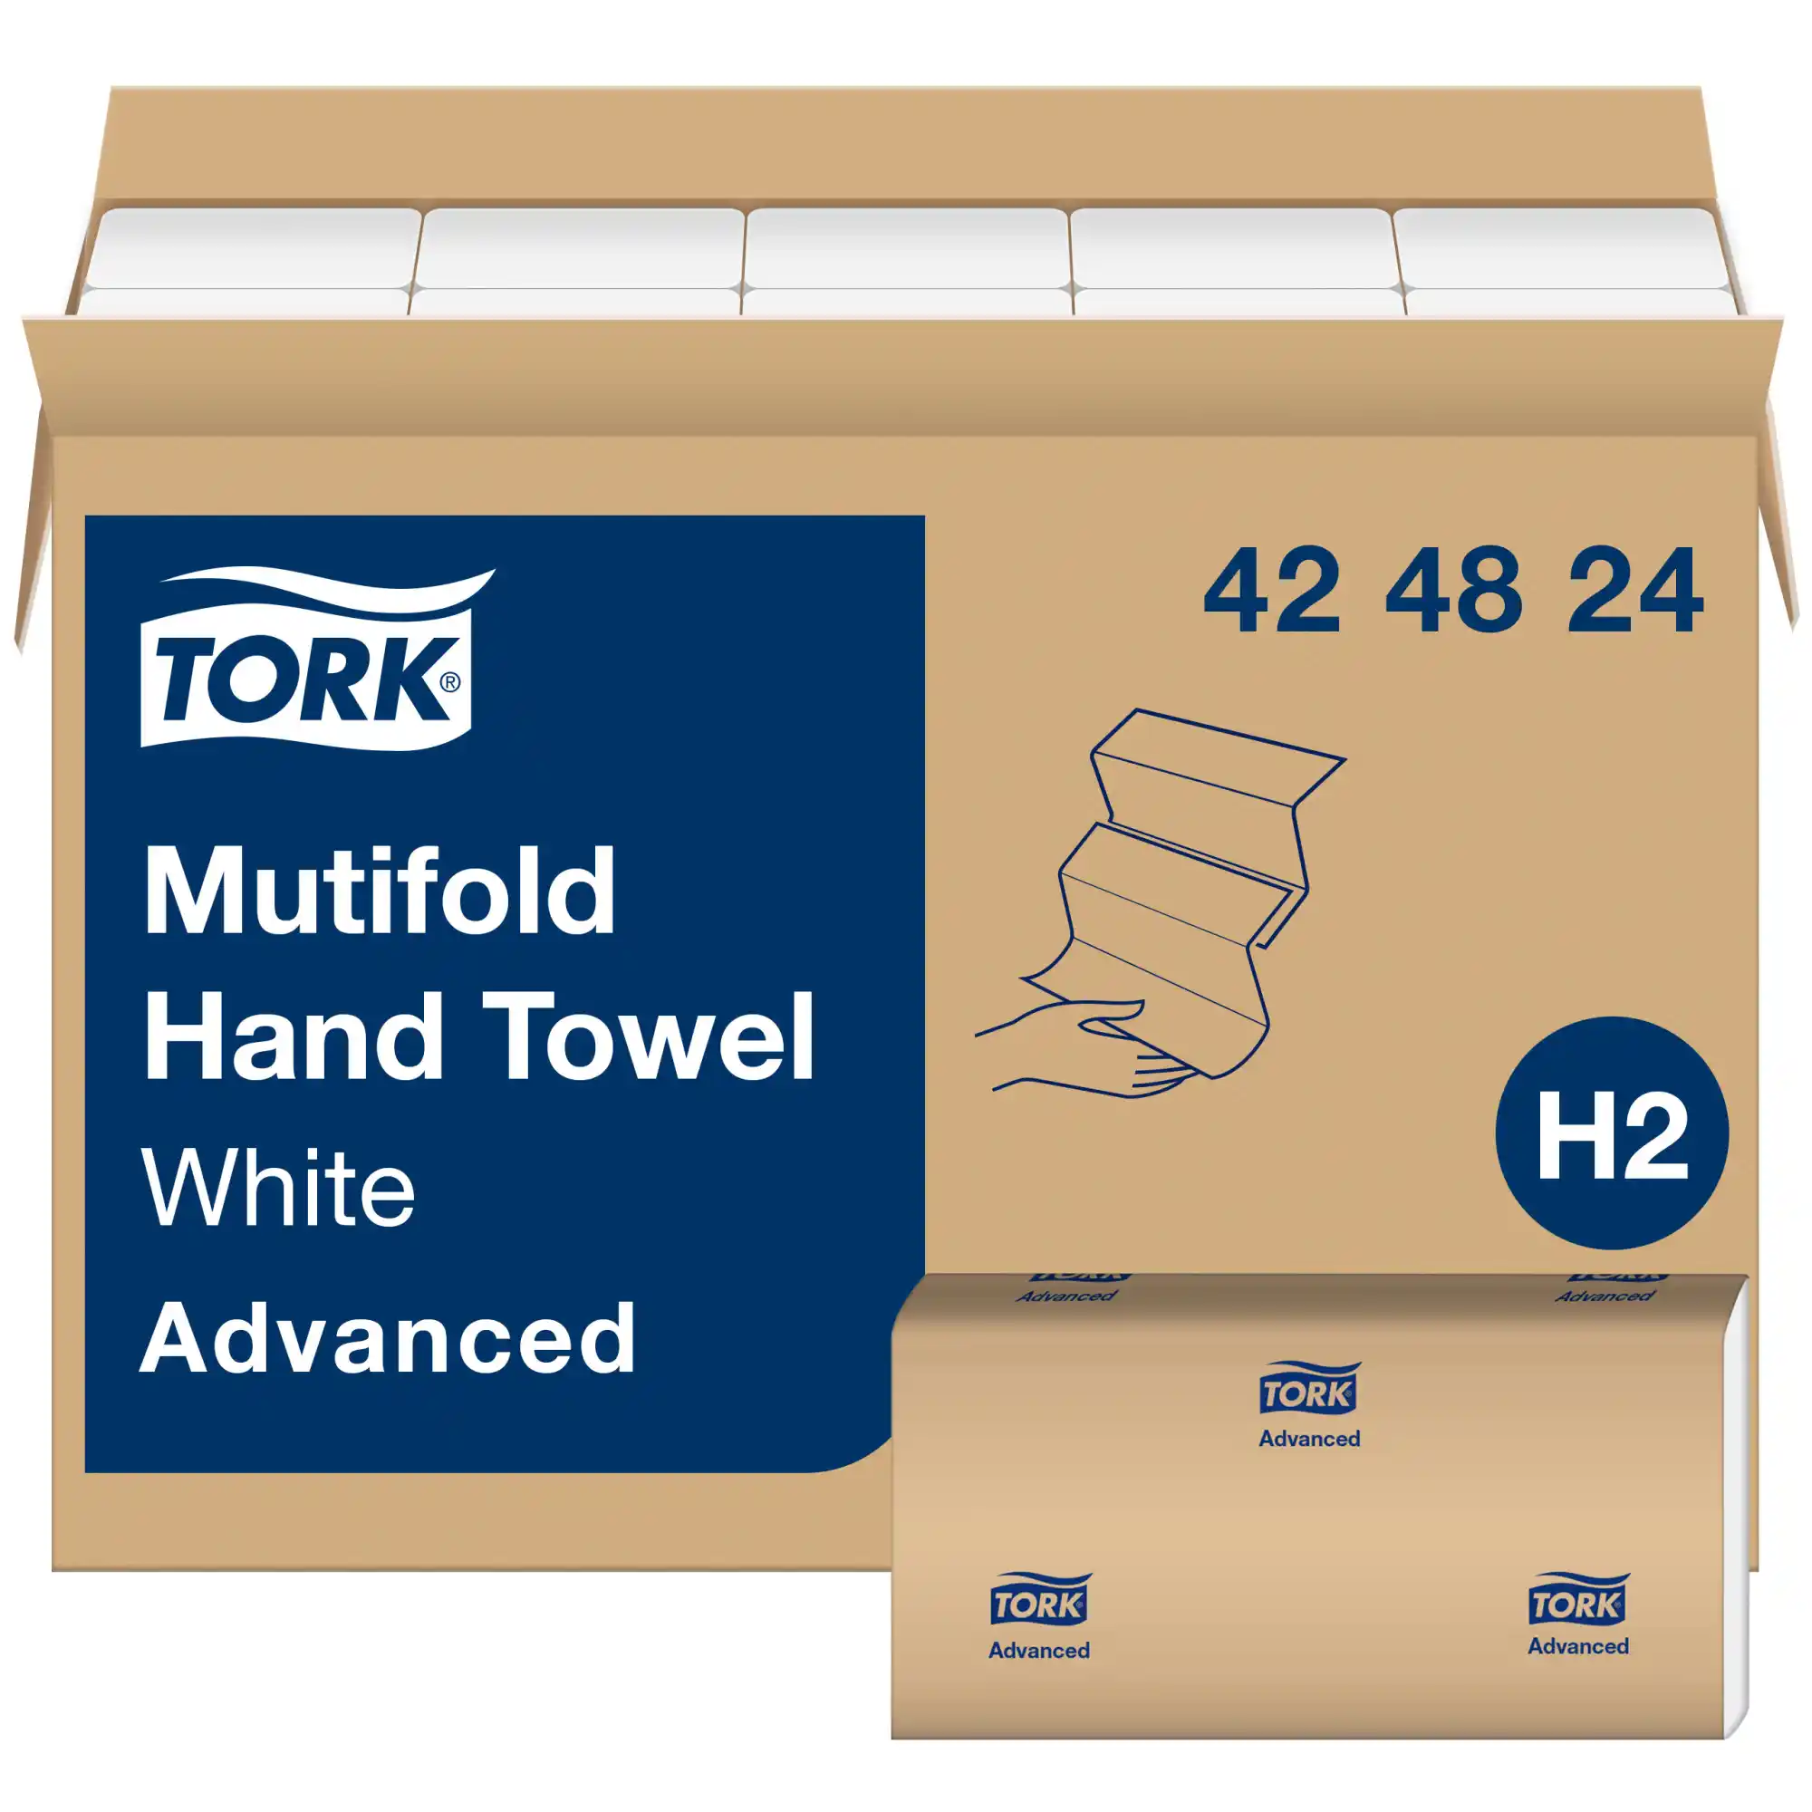
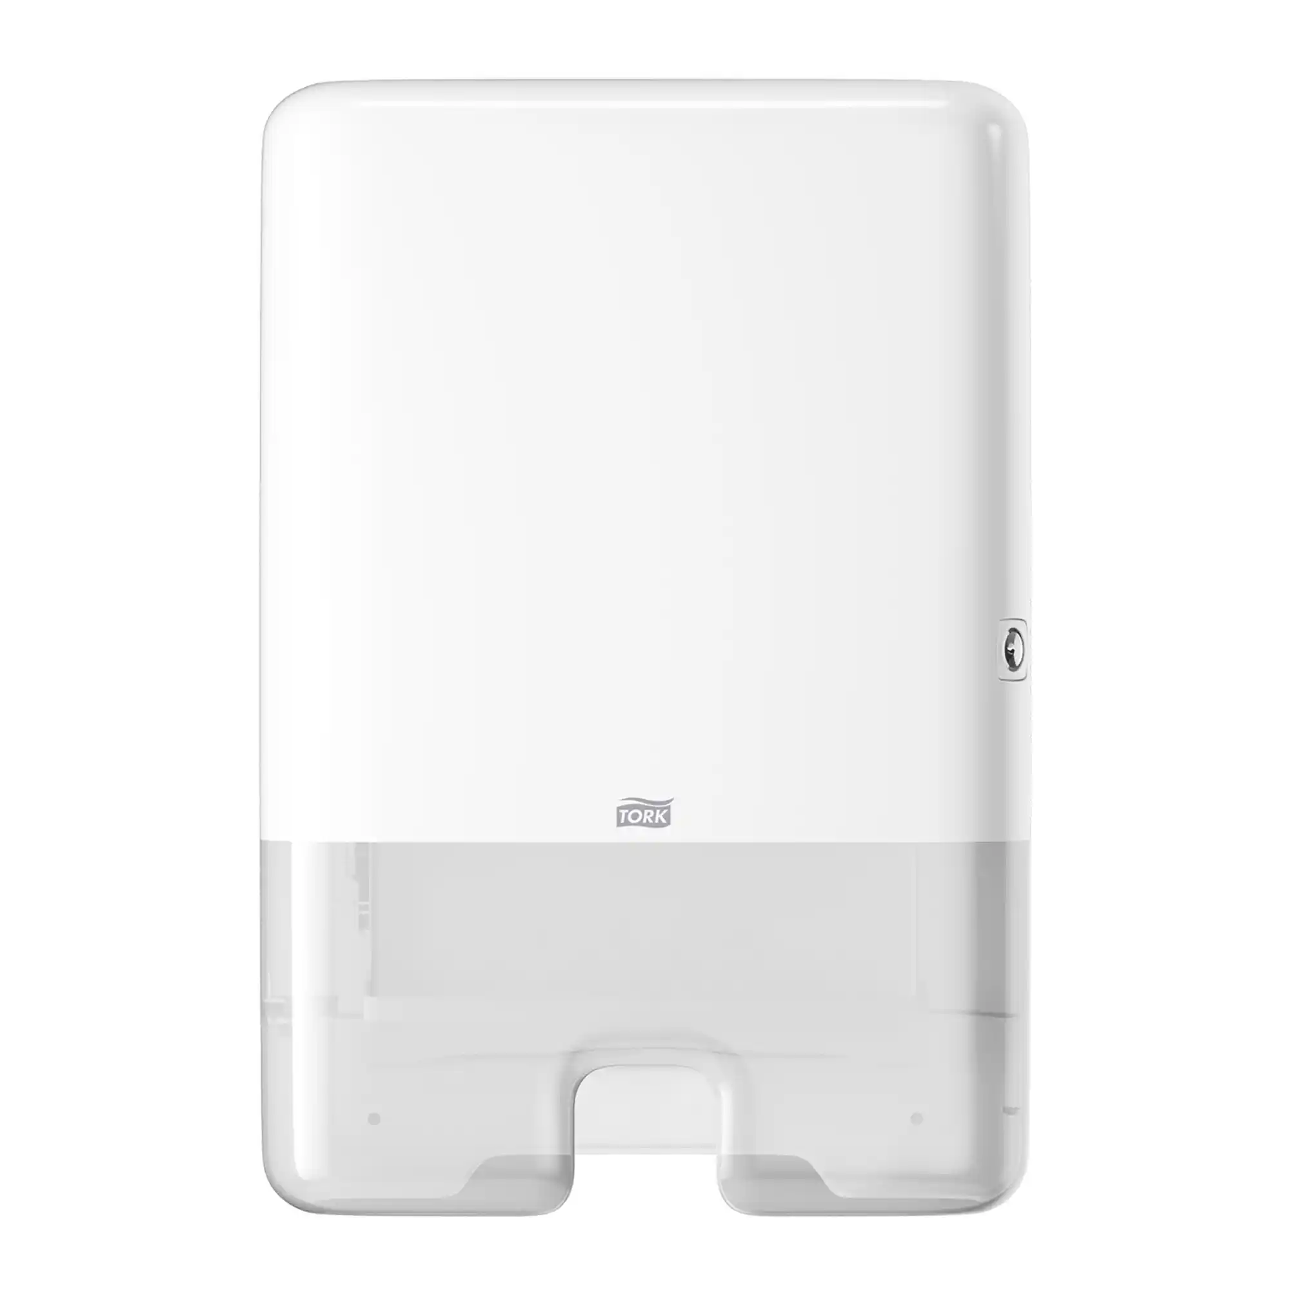
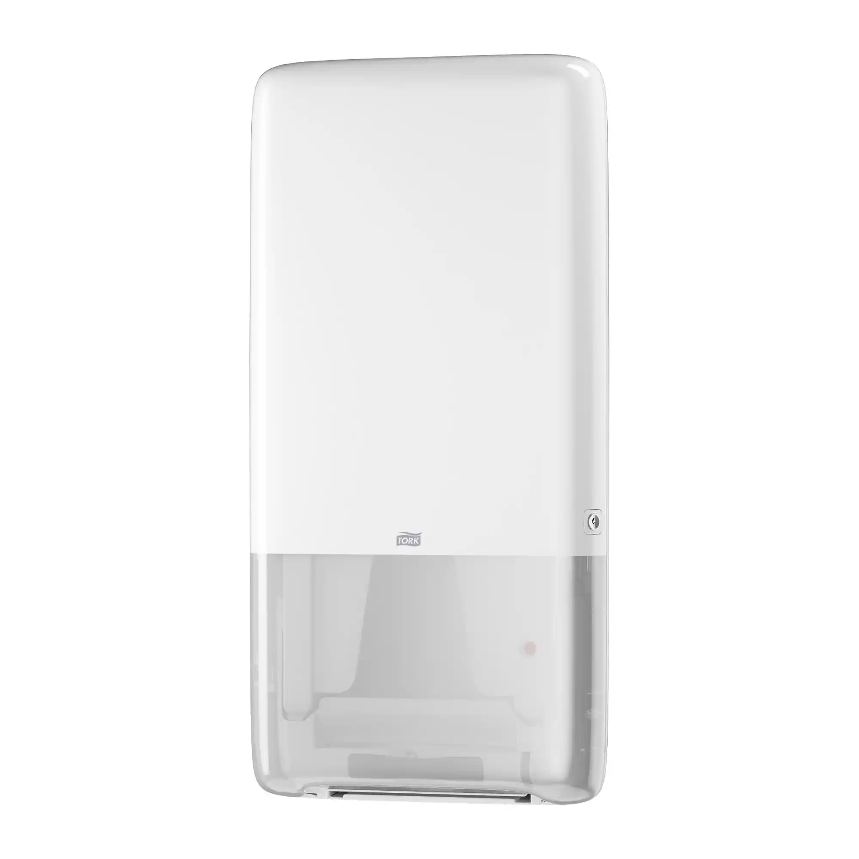
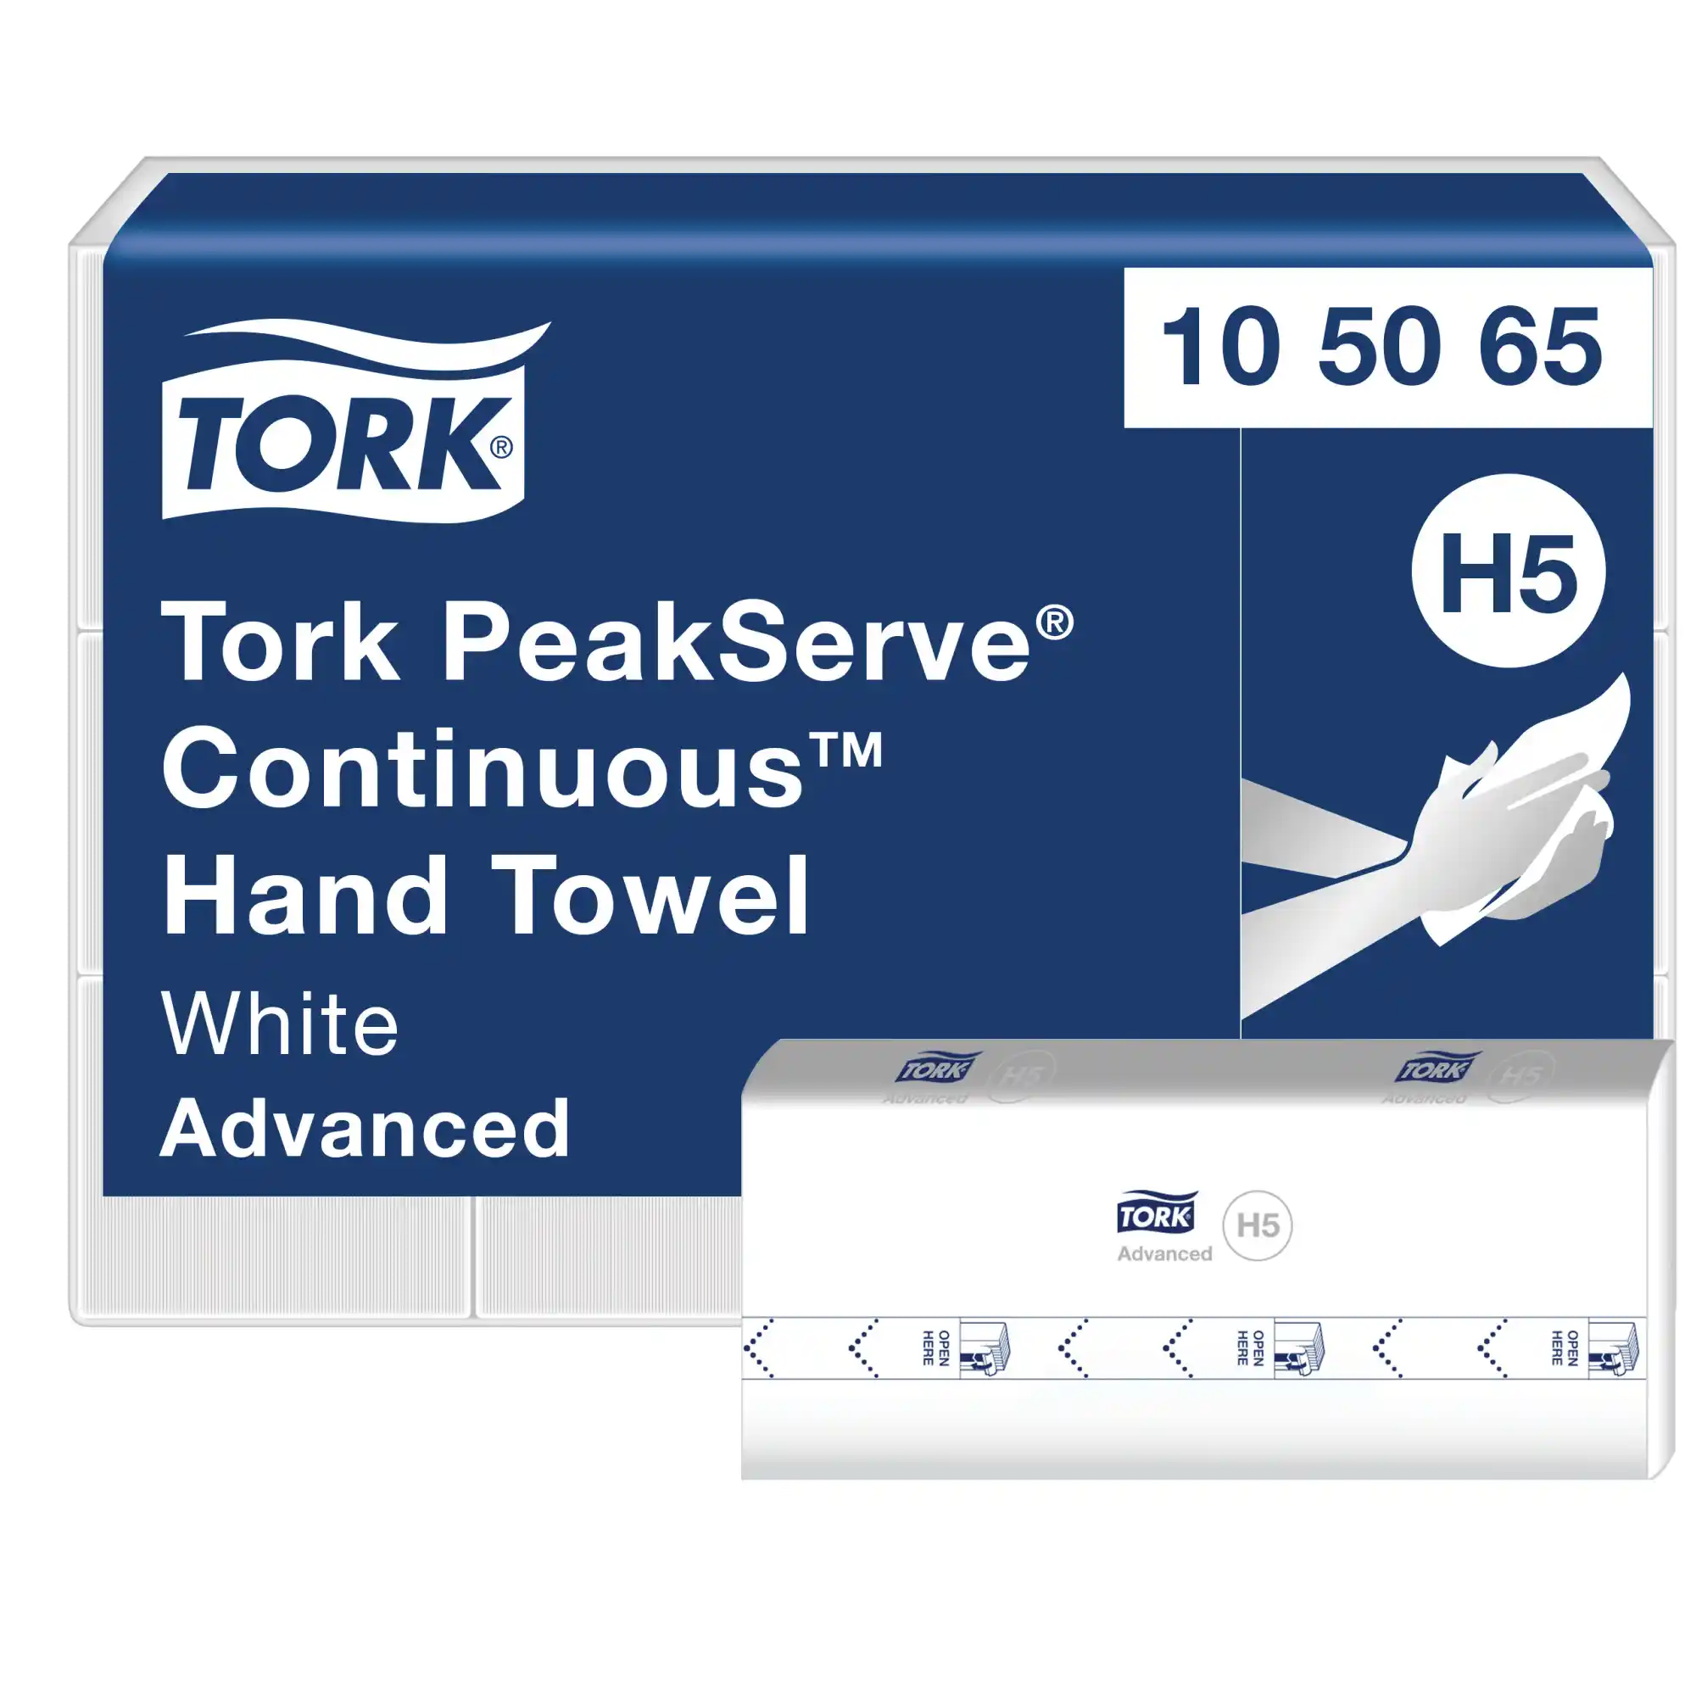
Paper Towel Dispensers and Compatible Supplies
(Refills supplied by Contractor)

Slide 4
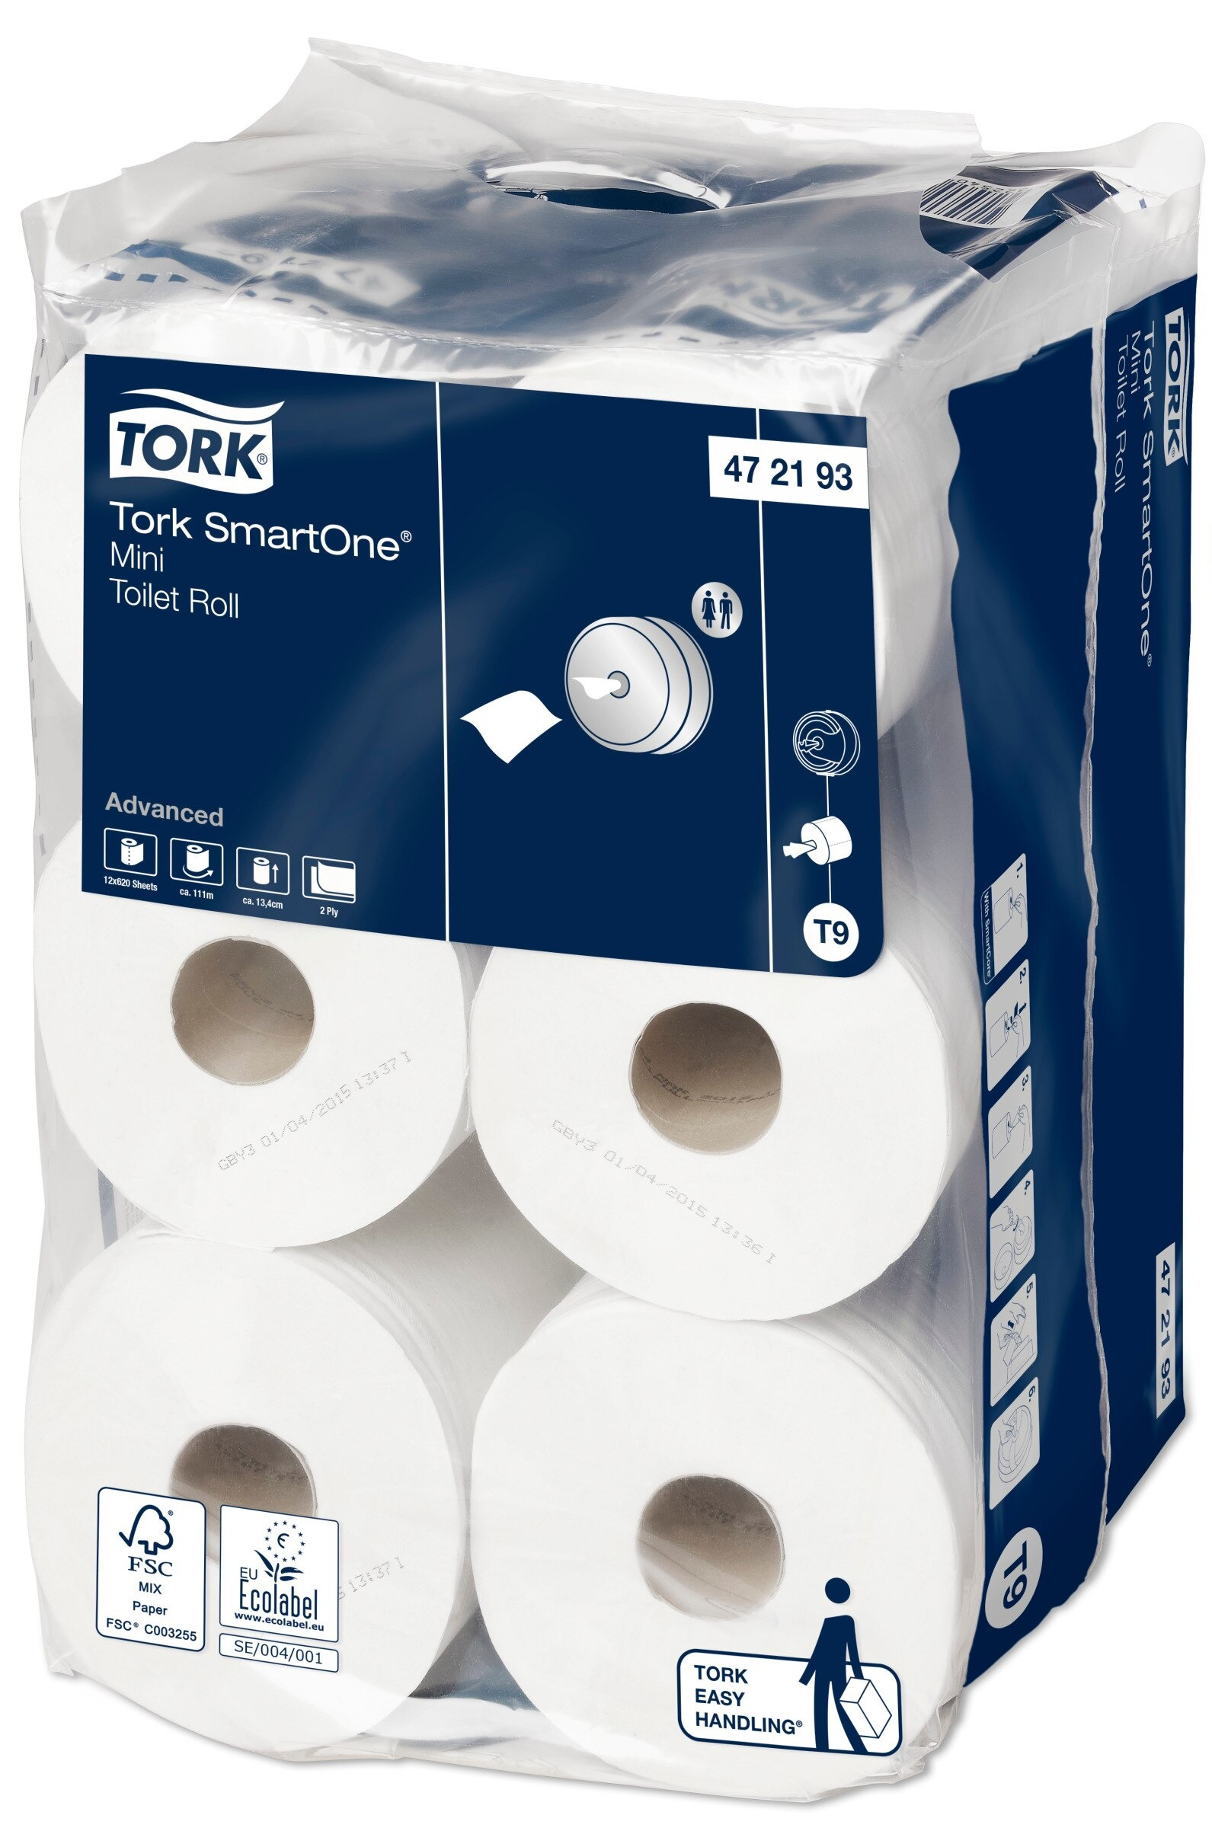
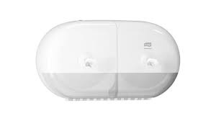
Toilet Paper Dispensers and Compatible Supplies
(Refills supplied by Contractor)

Slide 5
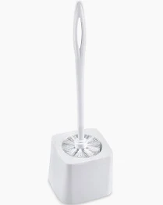
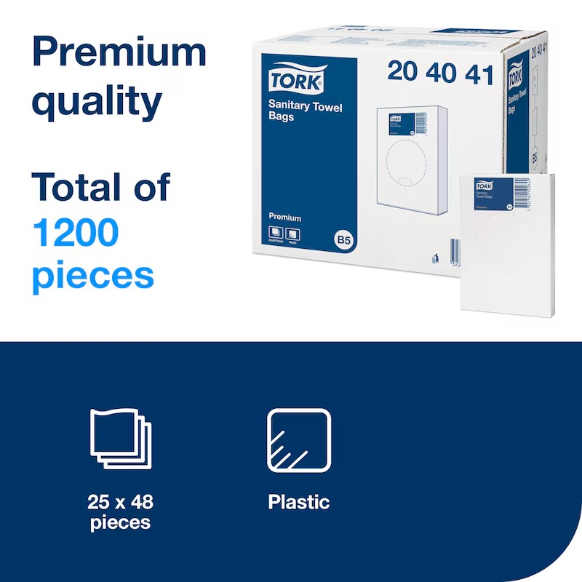
Additional Supplies Provided by Contractor
Toilet Brushes
Sanitary Towel Bags

