Slide 1
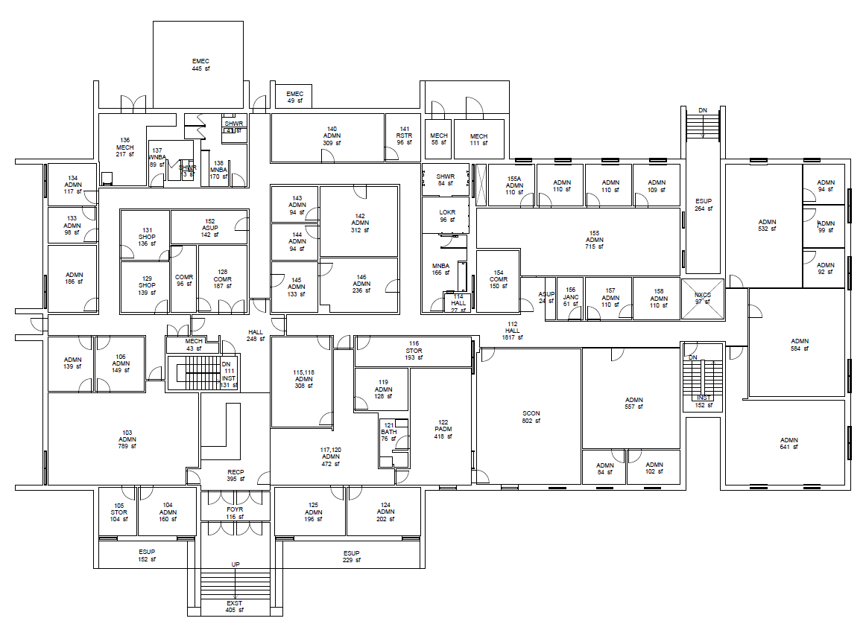
BLDG 9190
Main Floor
GCR

Slide 2
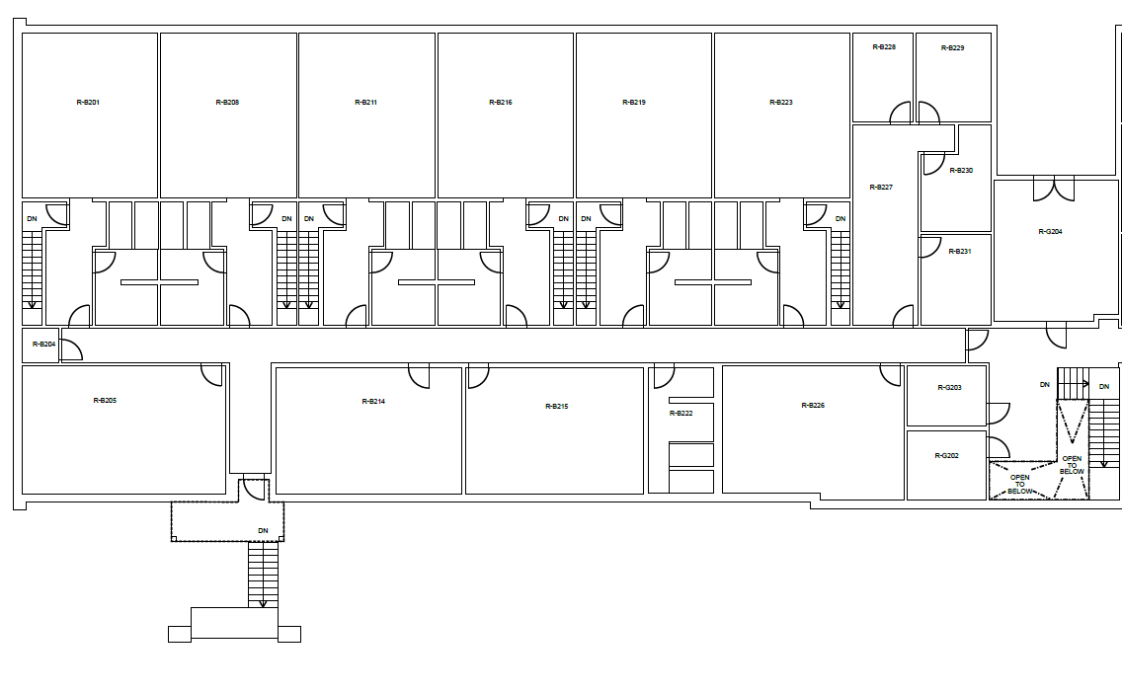
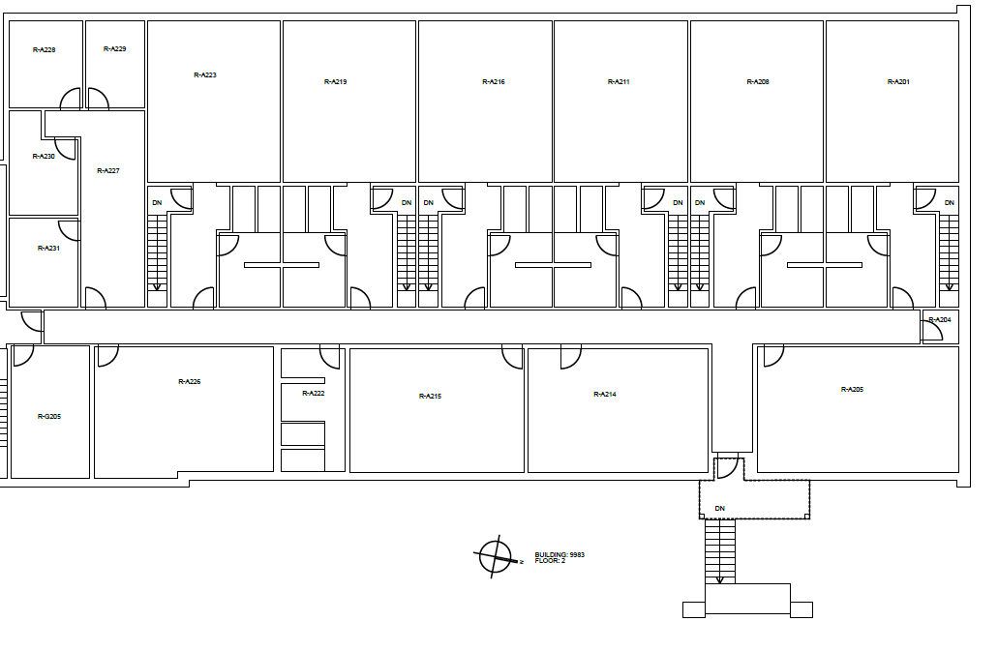
BLDG 9983
Second Floor
G202

Slide 3
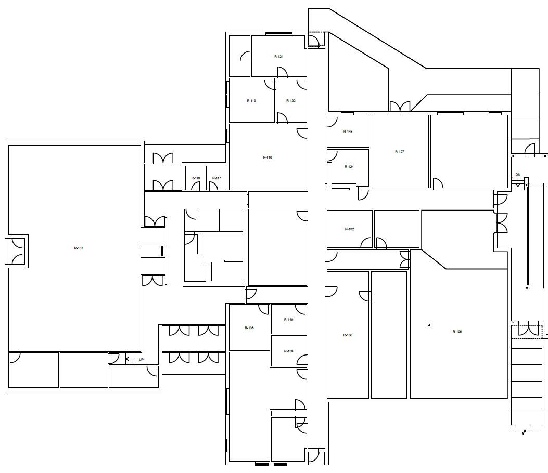
BLDG 9160 East
139

Slide 4
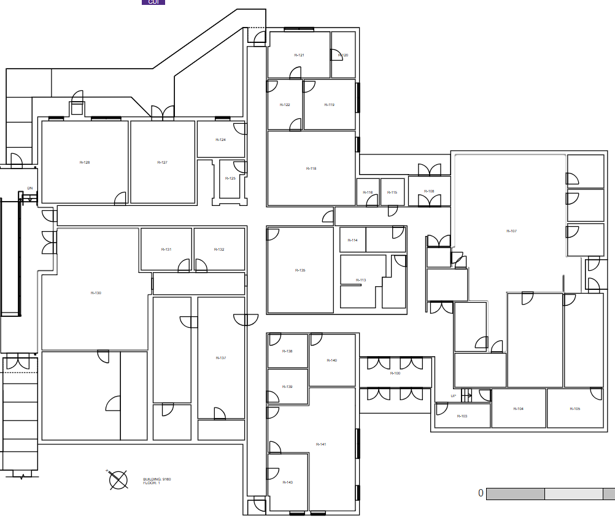
BLDG 9160 West
139

Slide 5
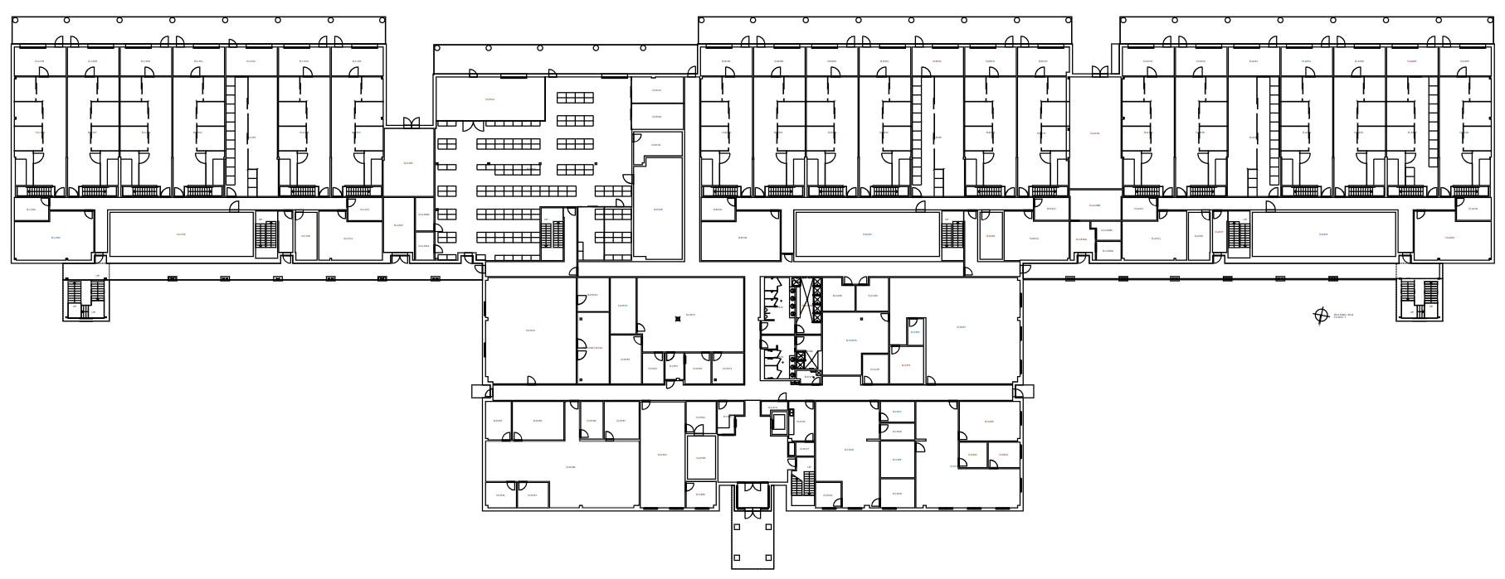
BLDG 9934
First Floor
G103B
G103A
G105B
G105A
H120
G108
G109
NOTE: Room H120 contains two evaporators

Slide 6
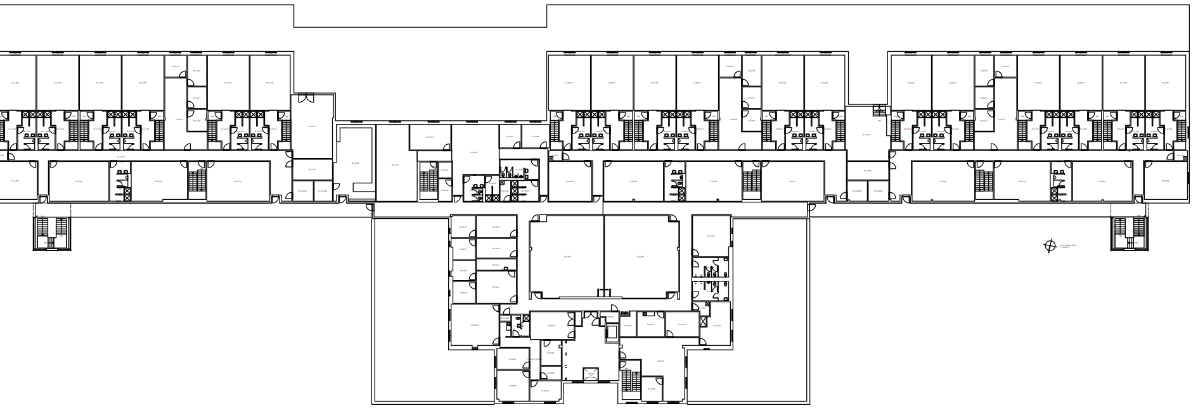
BLDG 9934
Second Floor
G203A
G203B
G205A
G205B

